Slide 1
Introduction to Eureka Math
2016-2017
Mrs. Duffy Mrs. Sullivan Ms. Loughran Ms. Shaw Ms. Matula

Slide 2
2016-2017 Math in District 128
This year we will continue to focus deeply on the major work of each grade so that our students gain strong foundations: solid conceptual understandings, a high degree of procedural skill and fluency, and the ability to apply the math they know to solve problems inside and outside the classroom
This year our math committee will continue to study programs, analyze data and pilot units so that we make the best decision in the adoption of new k-5 math materials for the 2017-2018 school year
Notes:
ML

Slide 3
Third Grade Math Standards
The new Illinois standards adopted in 2011 call for a greater focus and are significantly deeper than the 1996 Illinois standards
The standards are designed around coherent progressions from grade to grade in order to develop deep conceptual understandings of core content
Students are asked to use math flexibly for applications, apply the math in a context, particularly in science
There is an emphasis on process and proficiencies versus getting the answer
The newer standards represent significant curricular acceleration in grades k-8, with much of Algebra 1 and Geometry now in the middle grades
Notes:
ML

Slide 4
What to expect in Third Grade?
The Eureka Math curriculum provides more rigor and strategic thinking to prepare students for the future.
Content is divided into Modules according to Common Core State Standards.
Problem solving often includes more critical thinking in the form of word problems.
Students are expected to apply the R.D.W (Read Draw Write) process in each problem.
Nightly homework will be sent home along with a Homework Helper page for parent reference covering the current lesson.
Each Module will have a Mid-Module and End-of-Module assessment that will be graded using a rubric.
Study guides are sent home before every assessment and will be reviewed in class prior to the assessment.

Slide 5
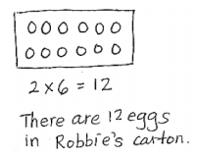
R.D.W : Read Draw Write
In the R.D.W process students are expected to answer each question with a picture, number sentence (2 x 6 = 12), and word sentence. The idea behind this strategy is to get students used to explaining their thought process when solving a problem.
Points are given on assessments for each component of the R.D.W process.
See sample problem below.

Slide 6
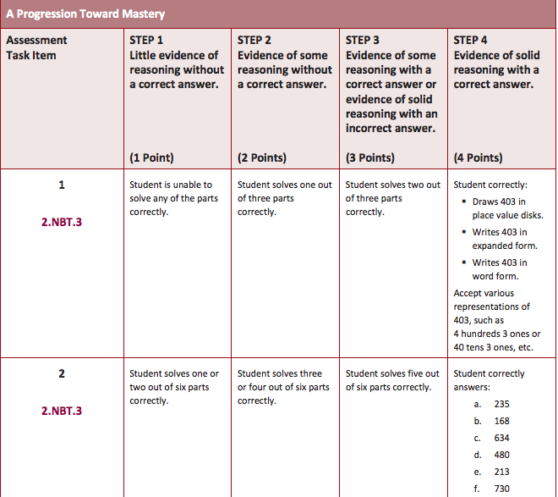
Grading
Rubrics are organized by individual problem and the corresponding Common Core Standards.
See sample rubric from 2nd Grade Eureka curriculum.

Slide 7
Materials
Each student will be given a workbook that will be brought home nightly and returned to school the next day.
Workbooks include the problem set, homework, and supporting templates.
Problem sets are completed in class and should be used as a resource/guide when completing homework.
Exit Tickets are given the day after the lesson as a formative assessment.
Homework is turned in daily, corrected, and returned in the Friday Folders with all Exit Tickets for the week.
Each student will be given an IXL password which gives them access to an online math practice with immediate feedback. Students will log in to IXL both at home and at school.
Notes:
Explain- what IXL is - add more detail

Slide 8
Differentiation
Students will rotate classrooms weekly based on ongoing classroom data (formal and informal) for interventions/enrichment to best meet the student’s instructional needs.
Instruction during the differentiation times will be mirrored to current week lessons.
Math games will be incorporated for a brain-friendly learning environment and skill reinforcement.

Slide 9
How can parents support their student?
We encourage parents to monitor their students as homework is completed. Parents and students may review the problem set completed in class and use it as a guide.
Review the Homework Helper handout sent home in your student’s homework folder to familiarize yourself with the current strategies used in class.
The Great Minds (Eureka) website offers a parent support page that includes Homework Helpers, Videos, Module Tip Sheets, and FAQ’s. http://greatminds.net/support/parents
Studying basic math facts (addition, subtraction, multiplication, and division) would greatly behoove your student and assist in building their mathematical fluency.
Notes:
Remind parents to allow students to make mistakes so the teachers know if a skill or standard needs to be retaught

Slide 10
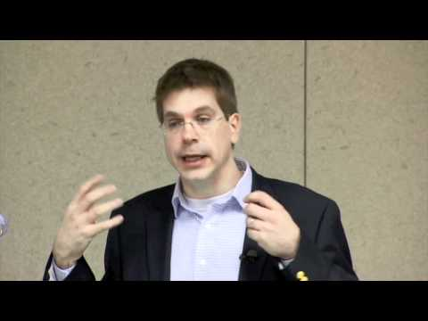
Why is Fluency important?
Math fact fluency allows students more time to concentrate on the strategy of a problem.
Students who have mastered their facts will approach a problem with more confidence, greater number sense , and conceptual understanding.
See attached video.

Slide 11
Teacher-Parent Communication
Weekly newsletters will include information on the math lessons for the week and new strategies introduced.
Homework Helpers will be sent home nightly in homework folders.
Please review corrected homework and Exit Tickets in Friday Folders to determine skills that need additional practice.
Please contact your student’s teacher with individual questions and/or concerns.
Please contact Mrs. Duffy with questions pertaining to the district math programs.

